Slide 1
Lesson: Computer systems and system software
Computer systems
Notes:
Resources are updated regularly - the latest version is available at: the-cc.io/curriculum.
This resource is licensed by the Raspberry Pi Foundation under a Creative Commons Attribution-NonCommercial-ShareAlike 4.0 International license. To view a copy of this license, visit, see creativecommons.org/licenses/by-nc-sa/4.0/.

Slide 2

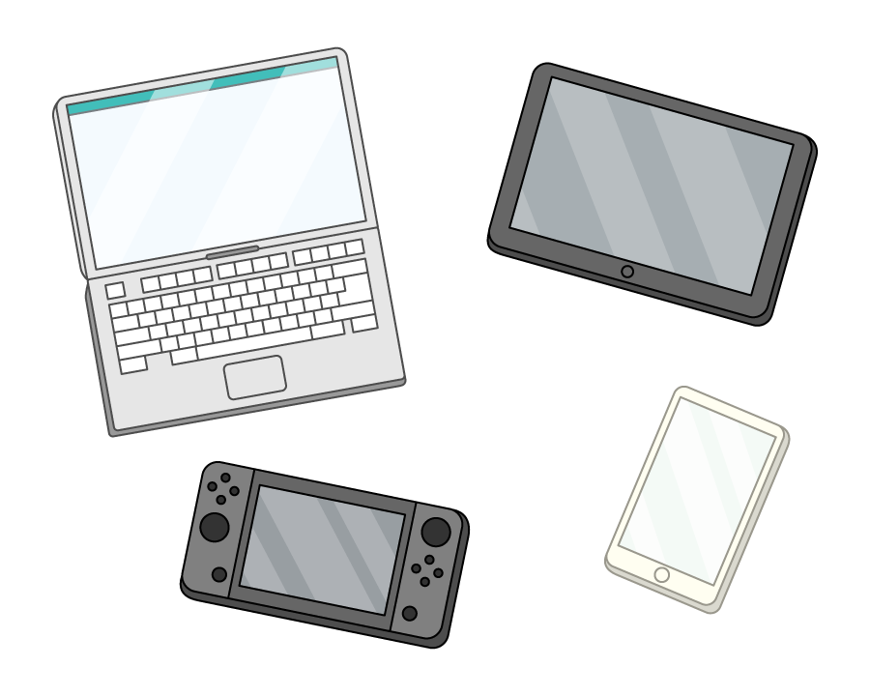
What makes a computer?
Starter activity
What characteristics does a device need to have to be considered a computer?
Discuss with the person next to you.

Slide 3
What makes a computer?
Starter activity
Which of these devices are computers? Do they have the characteristics you discussed?
Mobile phone
Video game console
A tablet
Calculator
Smart watch
Laser pointer
Coffee machine

Slide 4
What is a computer?
Starter activity
A programmable device that takes in data, processes it into useful information, and then outputs the information so it can be used.
This is often described in the computing cycle you can see on the right.
Input
Process
Output
Storage

Slide 5
Spot the embedded systems
Activity 1
Both a mobile phone and a coffee maker are computers, but they are very different devices.
Computer systems can be categorised as either:
General purpose
Embedded systems
How would you categorise the mobile phone and coffee maker?

Slide 6
Spot the embedded systems
Activity 1
Mobile phone: General purpose
Coffee maker: Embedded system

Slide 7


Spot the embedded systems
Activity 1
General purpose computers are devices that have a variety of uses, the user chooses the task for the computer to complete.
Embedded systems are more specialised, they can only do a limited number of things, but they do them very well.

Slide 8
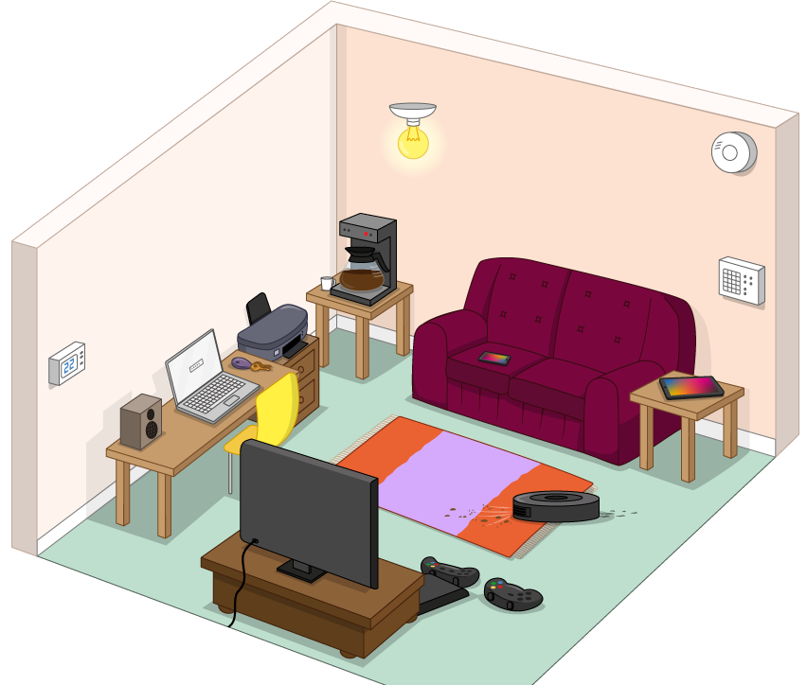
Spot the embedded systems
Activity 1
Inside this room there are lots of computers. Some of them are general purpose and others are embedded systems.
On your own, sort them into two lists.
Embedded
General purpose

Slide 9
Spot the embedded systems
Activity 1
General purpose:
Used for many different types of tasks
Lots of resources — memory, storage, CPU cores
Most tasks require a user
Embedded systems:
?
?
?

Slide 10

Spot the embedded systems
Activity 1
Embedded systems
Coffee machine
Vacuum robot
Thermostat
Security system
Bluetooth speaker
…?

Slide 11
Spot the embedded systems
Activity 1
General purpose:
Used for many different types of tasks
Lots of resources — memory, storage, CPU cores
Most uses require a user
Embedded systems:
Specialised to a specific task/set of tasks
Limited resources
Often function without a user

Slide 12
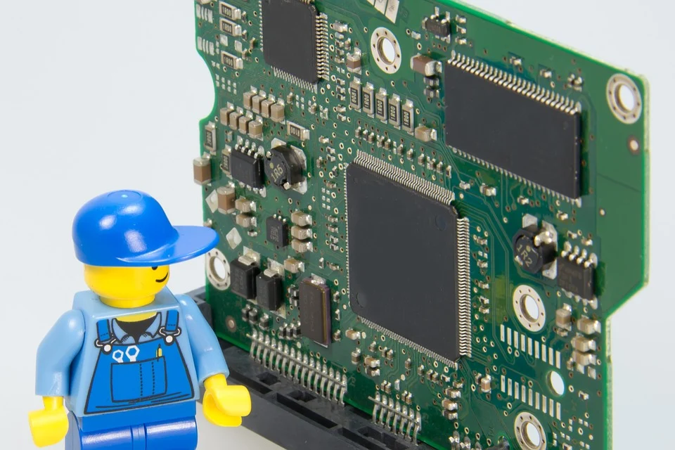
The start-up sequence
Activity 3
Computers work due to a combination of:
Hardware components
Software
You are going to examine how they work by looking at what happens when you press the power button.
First, you need to learn about some important components.
Notes:
Image source: https://pixabay.com/photos/electrician-lego-repair-craftsmen-499799/

Slide 13
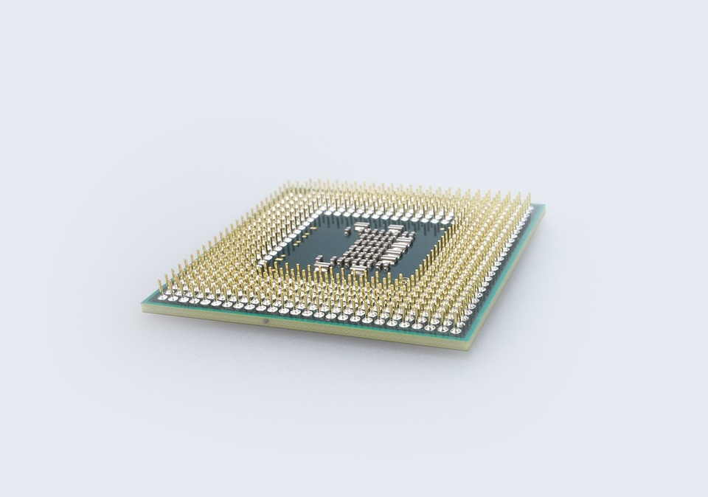
The start-up sequence
Activity 3
The CPU
The central processing unit, is a large chip inside the computer.
It is the brains of the computer: it controls everything.
Notes:
Image source: https://pixabay.com/photos/cpu-processor-electronics-computer-447483/

Slide 14
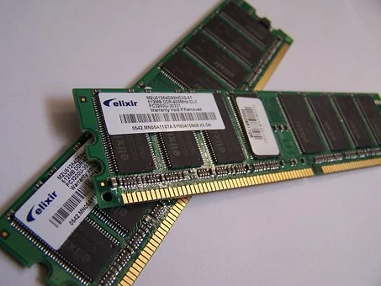
The start-up sequence
Activity 3
RAM
Random access memory
RAM is both readable and writable. You can add, change, and delete data stored in RAM.
It is volatile. When the computer is switched off, all the data stored in RAM is lost.
It is fast to read/write.
Notes:
Image source: https://pixabay.com/photos/computer-memory-chips-technology-857098/

Slide 15
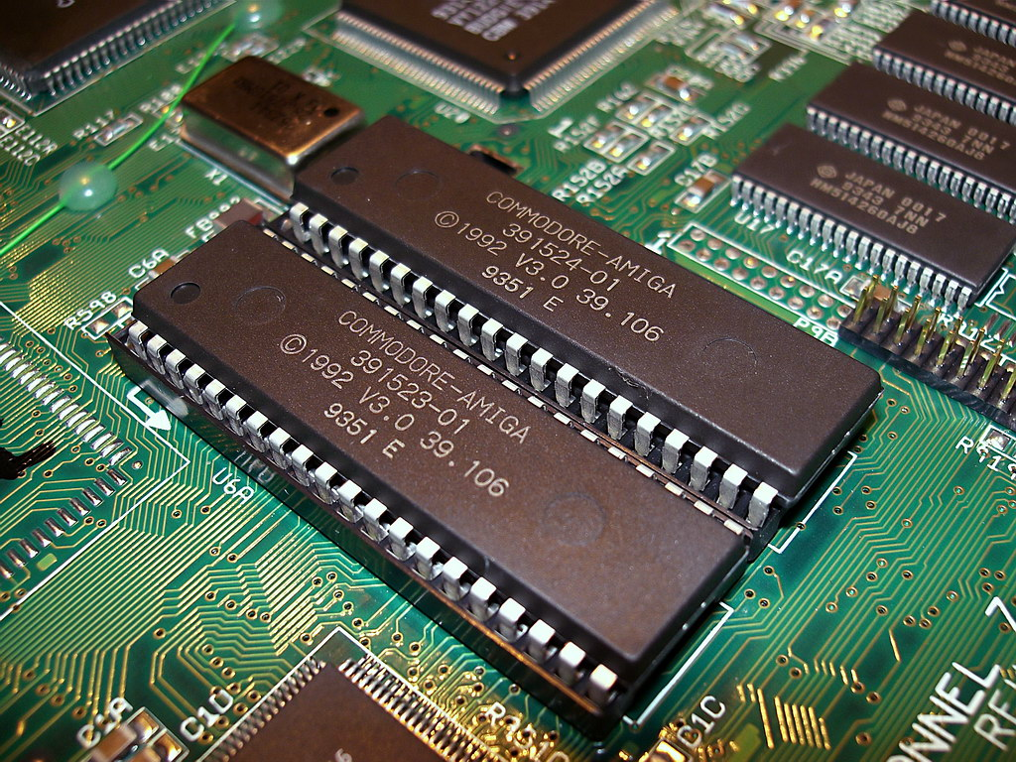
The start-up sequence
Activity 3
ROM
Read-only memory
ROM is read-only
ROM is non-volatile memory, which means it does not need power to keep the data inside it
It is also fast
Notes:
Source image: https://upload.wikimedia.org/wikipedia/commons/d/d3/Amiga_1200_Kickstart_3.0_ROMs.jpg

Slide 16
The start-up sequence
Activity 3
Hard drive
The hard drive, which contains multiple hard disks, is the main storage device in your computer.
If you have files and folders on your computer, they are stored on the hard drive. The operating system is also stored on the hard drive.

Slide 17
The start-up sequence
Activity 3
BIOS
Contains all the basic code for controlling your computer hardware (such as keyboards, mice, monitors, and hard drives).
When you start up your computer, you may see a black screen displaying ‘Press F2 for Setup’. This is the BIOS.

Slide 18
The start-up sequence
Activity 3
Your worksheet has the steps your computer goes through when you press the power button.
There is space for you to number the steps to put them in the right order.
You can do this with a partner, we will go through the steps after this.

Slide 19
The start-up sequence
Activity 3
The boot sequence begins
CPU starts up and fetches the BIOS from ROM
Notes:
The CPU controls everything and it is the first component to start. It first needs to grab the BIOS from ROM.
The BIOS is set by your manufacturer and shouldn’t be edited by a user.

Slide 20
The start-up sequence
Activity 3
Instructions from BIOS are loaded into RAM
Notes:
In order for any instructions to be executed, they need to be in RAM.
RAM is directly accessible by the CPU, it is where all instructions are stored before they are executed.

Slide 21
The start-up sequence
Activity 3
BIOS starts up the monitor and keyboard
Notes:
The very first thing your computer does is turn on the input and output devices for your computer.
This is so it can show the user any error messages it needs to while the rest of the start-up sequence is completed.

Slide 22
The start-up sequence
Activity 3
BIOS checks your computer is working
Notes:
Next, the BIOS does some basic checks to make sure your computer is working.
It will check the storage devices, and things like how much RAM there is on the computer. This will be important for the next steps.

Slide 23
The start-up sequence
Activity 3
Operating system is fetched from secondary storage
Notes:
The storage on your computer holds all the software your computer needs to run, including the operating system.
Before anything can be loaded into RAM, it first needs to be fetched from secondary storage.

Slide 24
The start-up sequence
Activity 3
Operating system is loaded into RAM
Notes:
In order for the CPU to run the operating system, it needs to be loaded into RAM.
Not every part of the operating system will be loaded at once, just the parts that it needs for the tasks at hand.

Slide 25
The start-up sequence
Activity 3
The BIOS hands over control to the operating system
Notes:
Once the operating system is loaded and ready to go, the BIOS does very little.
At this point, the operation of your computer is handed off to the operating system and you can run other pieces of software.

Slide 26
Operating systems and system software
Activity 4
Most computer systems require more than just a program to run.
Another layer of software is required called system software.
There are two main types of system software
Operating systems
Utility software
Notes:
Source image: https://pixabay.com/photos/electrician-lego-repair-craftsmen-499799/

Slide 27
Operating systems and system software
Activity 4
Software
IDEs
Video players
Browsers
System software
Video games
Text editors
Encryption
Interpreters
Operating systems
Hardware
BIOS
CPU
Peripherals
Storage
Memory

Slide 28
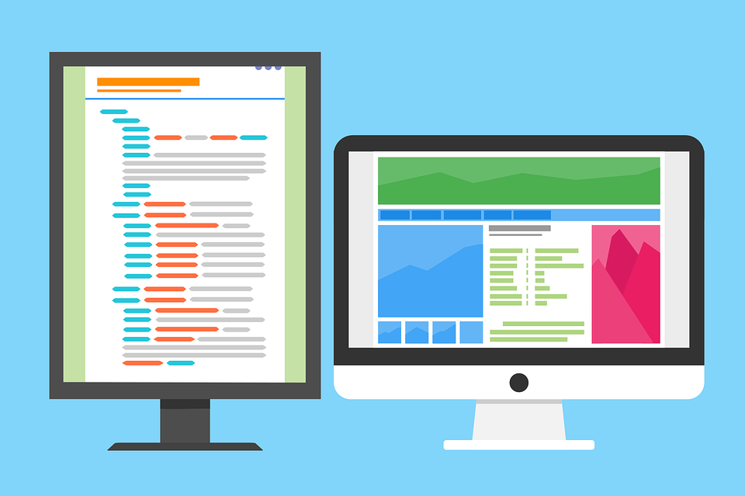
Operating systems and system software
Activity 4
Operating systems are pieces of software that regulate interactions between software and hardware.
There are lots of different operating systems. The most popular are:
Windows
macOS
Linux
Android
Notes:
Image source: https://pixabay.com/vectors/dual-screen-programming-coding-1745705/

Slide 29
Operating systems
Activity 4
Roles of the operating system:
Error handling
Program management
Memory management
Interaction with the user
Processor management
Input and output
Security
File management
Notes:
Image source: https://pixabay.com/vectors/dual-screen-programming-coding-1745705/

Slide 30
The roles of an operating system
Plenary
Error handling | When a program fails or encounters a problem, the operating system protects the wider system from crashing.
Program management | Often our computers are running multiple processes at once. The operating system makes sure that each application has enough resources to accomplish its tasks.
Memory management | The operating system controls where each piece of data is stored in RAM.

Slide 31
The roles of an operating system
Plenary
Interaction with the user | The operating system provides a graphical user interface which makes operating the computer much simpler.
Processor management | Instructions are executed by the CPU, but the operating system controls which instructions are fed in to be executed.
Input and output | The operating system captures data from peripherals and provides data to the output devices to display to the user.

Slide 32
The roles of an operating system
Plenary
Security | The operating system stops unauthorised individuals from accessing data on secondary storage or the data in memory.
File management | When you save data to your hard drive, the operating system will find an available section of storage and send the data to be written to that location.

Slide 33
Lesson: The CPU
Computer systems
Notes:
Resources are updated regularly - the latest version is available at: the-cc.io/curriculum.
This resource is licensed by the Raspberry Pi Foundation under a Creative Commons Attribution-NonCommercial-ShareAlike 4.0 International license. To view a copy of this license, visit, see creativecommons.org/licenses/by-nc-sa/4.0/.

Slide 34

Utility software
Plenary
Utility software provides some enhanced functionality for a computer system.
They can be chosen and installed by the user, and aren’t necessary for a computer to function. They add to the performance of the computer.
Notes:
Image source: https://pixabay.com/vectors/screwdriver-settings-spanner-system-1294338/

Slide 35
Utility software
Plenary
Compression software
Encryption software
An email application
Defragmentation software
Antivirus software
Backup tools
Write a short paragraph explaining it to your classmates.
Notes:
Image source: https://pixabay.com/vectors/screwdriver-settings-spanner-system-1294338/

Slide 36
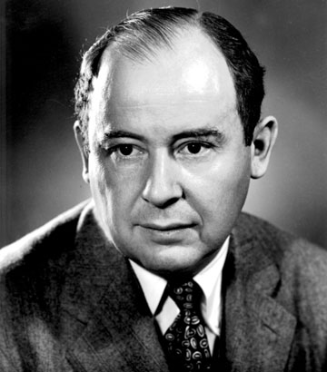
Von Neumann architecture
Activity 1
Computer architecture is a term used to describe the design of a computer system.
Modern computers use the von Neumann architecture designed by John von Neumann.
Von Neumann was a mathematician whose research has had a huge impact on a number of fields.
Notes:
Image source: https://upload.wikimedia.org/wikipedia/commons/a/a9/John_von_Neumann.jpg

Slide 37

Von Neumann architecture
Activity 1
Before von Neumann
In the beginning, computers were nowhere near as efficient or small as they are now.
The instructions they ran were hard-wired, physical switches that your data went through. This meant changing one thing in your program could take months to check.
Notes:
Image source: https://commons.wikimedia.org/wiki/File:Eniac.jpg

Slide 38
Von Neumann architecture
Activity 1
The stored program concept
Von Neumann proposed a new way to store and run programs on a computer.
His idea was to store common instructions in memory alongside the data, making computers much more versatile. This architecture has been widely adopted today.
Notes:
Image source: https://pixabay.com/photos/computer-memory-chips-technology-857098/

Slide 39
Von Neumann architecture
Activity 1
Data and instructions are stored as binary digits
The instructions are fetched from memory, one at a time in order (serially)
The processor decodes instruction before it executes it
In order to follow this system, modern CPUs contain several key components that all play a role.
Notes:
Image source: https://commons.wikimedia.org/wiki/File:Eniac.jpg

Slide 40

Von Neumann architecture
Activity 1
The CPU
Input
Output
Main Memory

Slide 41
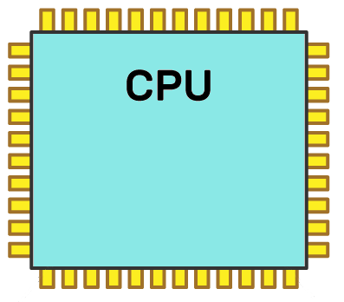
Inside the CPU
Activity 2
CPU stands for central processing unit.
Inside of the CPU, there are a number of key components:
Control unit
Arithmetic logic unit
Buses
Registers
Clock
Bus
Clock
Bus
ALU
Control Unit
Bus
Bus
Registers

Slide 42
Inside the CPU
Activity 2
Control unit
The control unit is organised, efficient, and collaborative.
What does it control, manage, or store?
It manages the instructions, and controls the other components.
Control Unit

Slide 43
Inside the CPU
Activity 2
Arithmetic logic unit (ALU)
The ALU is logical, good with numbers and precise.
What does it manage, control, or store?
It manages calculations and logic.
ALU

Slide 44
Inside the CPU
Activity 2
Clock
What characteristics does the clock need to have?
Punctual, reliable, and good rhythm.
What does it manage?
The cycles per second.
Clock

Slide 45
Inside the CPU
Activity 2
Registers
These are very small, very fast memory locations located inside the CPU. There are a few key registers.
Memory address register (MAR)
Memory data register (MDR)
Current instruction register (CIR)
Program counter (PC)
Accumulator (Acc)
Registers

Slide 46

Inside the CPU
Activity 2
Registers
Each stores and manages specific useful data.
Memory address register
Stores memory addresses used when searching for data in RAM.
Memory data register
Stores the data when fetched from memory.
Registers

Slide 47
Inside the CPU
Activity 2
Registers
Current instruction register
Holds the binary representation of the instruction to be executed.
Program counter
This register counts up as each instruction is executed, keeping track of how many instructions are in a program.
Registers

Slide 48
Inside the CPU
Activity 2
Buses
Social, fast, and efficient.
What is a bus?
A communication pathway along which data signals are transmitted around the CPU.
Bus
Bus
Bus
Bus

Slide 49
Lesson: Main memory
Computer systems
Notes:
Resources are updated regularly - the latest version is available at: the-cc.io/curriculum.
This resource is licensed by the Raspberry Pi Foundation under a Creative Commons Attribution-NonCommercial-ShareAlike 4.0 International license. To view a copy of this license, visit, see creativecommons.org/licenses/by-nc-sa/4.0/.

Slide 50
Main memory
Activity 1
RAM: Random access memory
ROM: - Read-only memory
Annotate your graphic organiser with the full names of main memory.
Notes:
Image source: https://pixabay.com/photos/computer-memory-chips-technology-857098/

Slide 51
Main memory
Activity 1
RAM and ROM are both types of main memory.
This means that they are directly accessible by the CPU.
Memory is used to store instructions for the CPU to execute.
They are much faster to access than storage — i.e. a hard drive.
Notes:
Image source: https://pixabay.com/photos/computer-memory-chips-technology-857098/

Slide 52
Main memory
Activity 1
ROM | Read only
RAM | Read and write
Notes:
Image source: https://pixabay.com/photos/computer-memory-chips-technology-857098/

Slide 53
Main memory
Activity 1
RAM | Stores instructions and data ready for a CPU to execute
ROM | Stores permanent instructions that tell a computer how to ‘boot up’
Notes:
Image source: https://pixabay.com/photos/computer-memory-chips-technology-857098/

Slide 54
Main memory
Activity 1
If a computer system does not have enough RAM, it will run slowly.
As a program executes, the instructions are loaded into RAM from secondary storage.
The CPU then takes the instructions from RAM and executes them.
Notes:
Image source: https://pixabay.com/photos/computer-memory-chips-technology-857098/

Slide 55
Main memory
Activity 1
Volatile is a term that means ‘data is lost when the power is switched off’.
Non-volatile means the opposite it ‘does not lose memory when the power is switched off’.
Notes:
Image source: https://pixabay.com/photos/computer-memory-chips-technology-857098/

Slide 56
Main memory
Activity 1
RAM | Volatile
ROM | Non-volatile
Notes:
Image source: https://pixabay.com/photos/computer-memory-chips-technology-857098/

Slide 57
Main memory
Activity 1
ROM | 6–8MB
RAM | 1–256GB
Notes:
Image source: https://pixabay.com/photos/computer-memory-chips-technology-857098/

Slide 58
Main memory
Activity 1
A computer system may also use virtual memory.
If a program needs more memory than is available, the operating system will reserve some in secondary storage that acts as an extension of main memory.
Notes:
Image source: https://pixabay.com/photos/computer-memory-chips-technology-857098/

Slide 59
Lesson: Logic gates
Computer systems
Notes:
Resources are updated regularly - the latest version is available at: the-cc.io/curriculum.
This resource is licensed by the Raspberry Pi Foundation under a Creative Commons Attribution-NonCommercial-ShareAlike 4.0 International license. To view a copy of this license, visit, see creativecommons.org/licenses/by-nc-sa/4.0/.

Slide 60
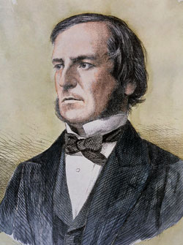
All very logical!
Activity 1
George Boole was an English mathematician who lived in the 1800s.
In 1847 he wrote a book called The Mathematical Analysis of Logic, in which he introduced Boolean algebra which used the logical states of True or False.
Notes:
This is just for background information for students, they do not need to take notes. Link the True and False to binary from the starter.
Image source: https://en.wikipedia.org/wiki/George_Boole#/media/File:George_Boole_color.jpg

Slide 61
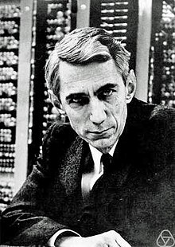
All very logical!
Activity 1
Later in 1940 Claude Shannon discovered that Boolean algebra could be applied to electrical circuits.
The True and False values could also be represented as 1 and 0.
Shannon’s discovery forms the basis of all electronic computers.
Notes:
This is just for background information for students, they do not need to take notes. Link the True and False to binary from the starter.
Image source: https://en.wikipedia.org/wiki/Claude_Shannon

Slide 62
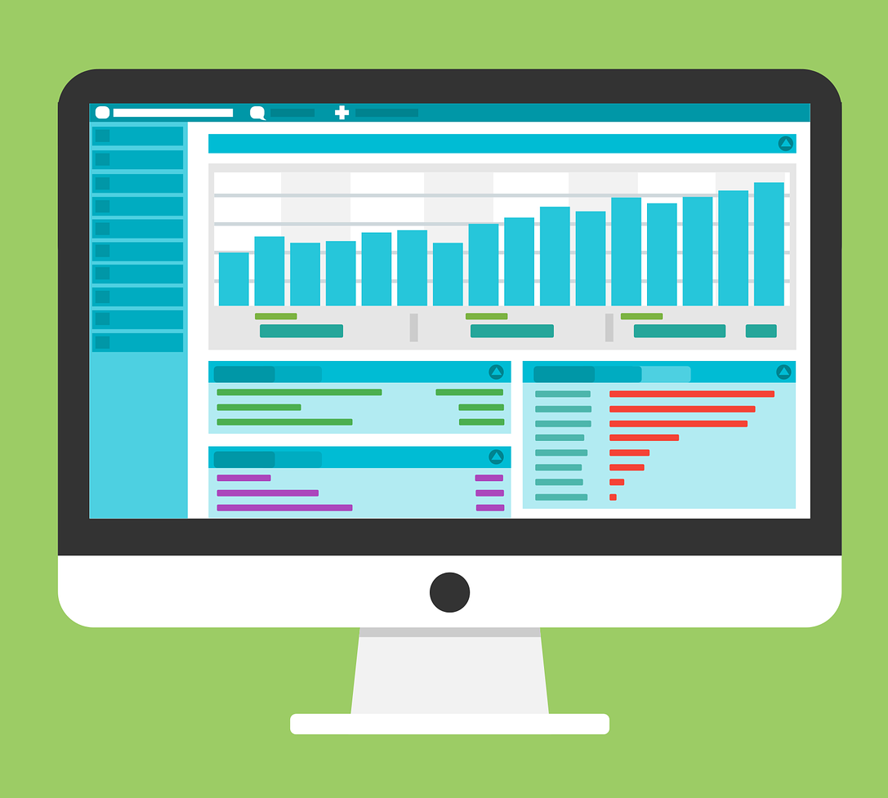
All very logical!
Activity 1
All computers have a central processing unit (CPU). The CPU processes the data and instructions for the computer.
This processing uses billions of tiny electronic components to carry out operations called logic gates.
Notes:
Image source: https://pixabay.com/vectors/statistic-wordpress-web-data-1820320/
Suggested activity: Learners to make notes about this theory in their book as you explain that this unit look at the very heart of the computer system: the logic gates that are the building blocks of the CPU.

Slide 63


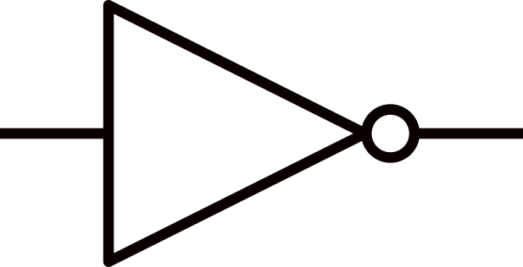
All very logical!
Activity 1
Logic gates use Boolean logic to take one or more inputs and produce a single output.
We use symbols to represent these gates in a circuit.
Notes:
Learners should make notes here as you talk about the properties of logic gates.

Slide 64
The three fundamental gates
Activity 1
There are three fundamental logic gates. These are AND, OR, and NOT.
AND
OR
NOT

Slide 65

All very logical!
Activity 1
Logic gates switch on and off, depending on the input that has been provided and the type of gate being used.
False
False
False
Notes:
Learners should make notes here as you talk about the properties of logic gates.

Slide 66
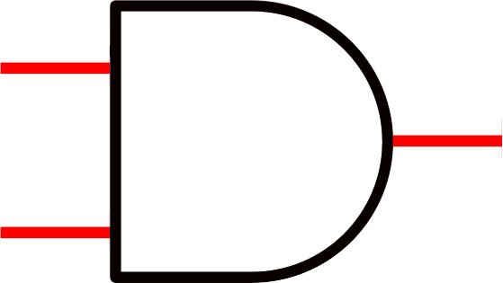
All very logical!
Activity 1
If the inputs evaluate to True, then an electrical current will flow through the gate.
The gate will be switched on.
True
True
True
Notes:
Learners should make notes here as you talk about the properties of logic gates.

Slide 67

All very logical!
Activity 1
If the inputs evaluate to False, then the electrical current will be stopped.
The gate will be switched off.
True
False
False
Notes:
Learners should make notes here as you talk about the properties of logic gates.

Slide 68
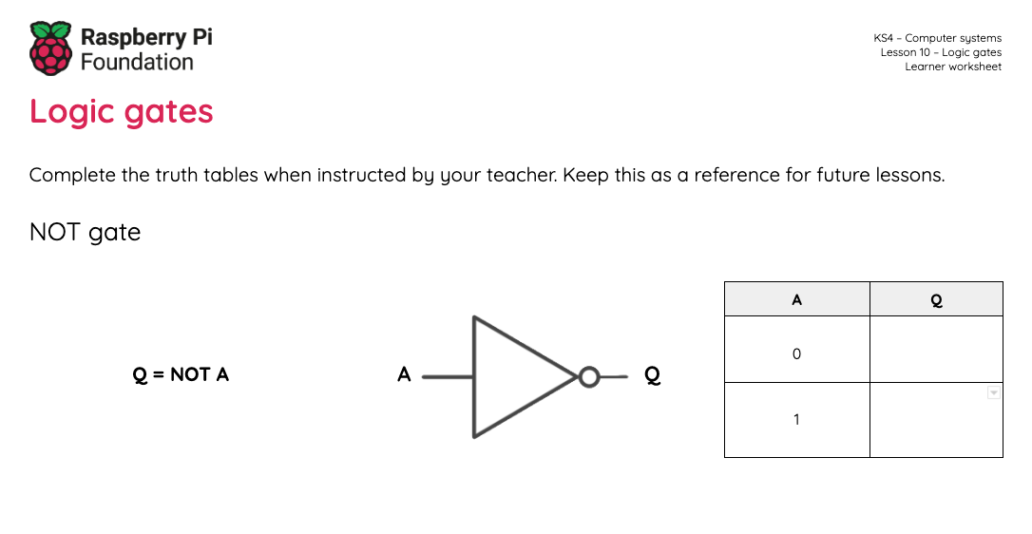
The three fundamental gates.
Activity 2
Open the ‘Logic gates’ worksheet.
There is space for you to make notes as we go through the three fundamental gates.

Slide 69
The three fundamental gates: AND
Activity 2
The AND logic gate takes two inputs.
An AND gate will only output as True (switch on) if both inputs are True.
inputs
output
All logic gates have a single output.

Slide 70
The three fundamental gates: OR
Activity 2
This is an OR gate.
An OR gate will output as True if one or both inputs are True.
True
True
False

Slide 71
The three fundamental gates: NOT
Activity 2
This is a NOT gate.
A NOT gate only has 1 input and 1 output.
The output is always the opposite of the input.
NOT gates are often referred to as inverters.
False
True

Slide 72
Putting it all together
Activity 3
Identify the inputs in the expression
“My security system will trigger if it is night-time and it detects movement.”

Slide 73
Putting it all together
Activity 3
Identify the inputs in the expression
“My security system will trigger if it is night-time and it detects movement.”

Slide 74
Putting it all together
Activity 3
Identify the inputs in the expression
Identify the output
“My security system will trigger if it is night-time and it detects movement.”

Slide 75
Putting it all together
Activity 3
Identify the inputs in the expression
Identify the output
“My security system will trigger if it is night-time and it detects movement.”

Slide 76
Putting it all together
Activity 3
Identify the inputs in the expression
Identify the output
Identify the logical operator
“My security system will trigger if it is night-time and it detects movement.”

Slide 77
Putting it all together
Activity 3
Identify the inputs in the expression
Identify the output
Identify the logical operator
Draw the logical diagram
“My security system will trigger if it is night-time and it detects movement.”
night
alarm
movement

Slide 78
Putting it all together
Activity 3
Identify the inputs in the expression
Identify the output
Identify the logical operator
Draw the logical diagram
Create the truth table
“My security system will trigger if it is night-time and it detects movement.”
Inputs |  | Output
A | B | Q
0 | 0 | 0
0 | 1 | 0
1 | 0 | 0
1 | 1 | 1

Slide 79
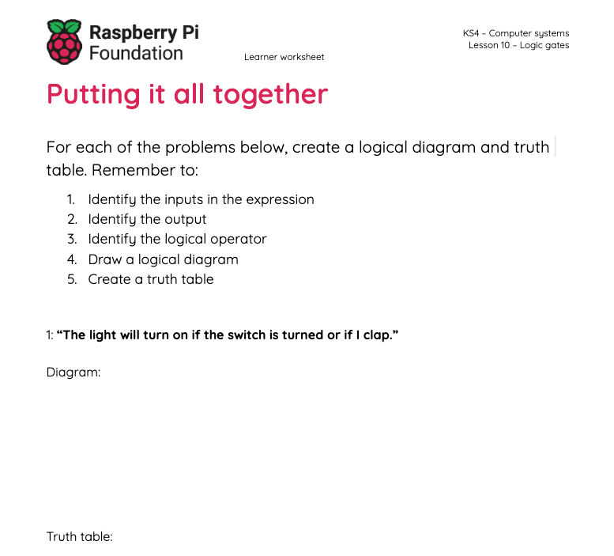
Activity: Putting it all together
Activity 2
Use the ‘Putting it all together’ worksheet to turn the statements into logic circuits with a truth table.

Slide 80
Solutions: Putting it all together
Plenary
“The light will turn on if the switch is turned or if I clap.”
Inputs |  | Output
A | B | Q
0 | 0 | 0
0 | 1 | 1
1 | 0 | 1
1 | 1 | 1
switch
light
clap

Slide 81
Lesson: What is a computer network?
Computer networks
Notes:
Last updated 30-11-2021
Resources are updated regularly - the latest version is available at: the-cc.io/curriculum.
This resource is licensed by the Raspberry Pi Foundation under a Creative Commons Attribution-NonCommercial-ShareAlike 4.0 International license. To view a copy of this license, visit, see creativecommons.org/licenses/by-nc-sa/4.0/.

Slide 82
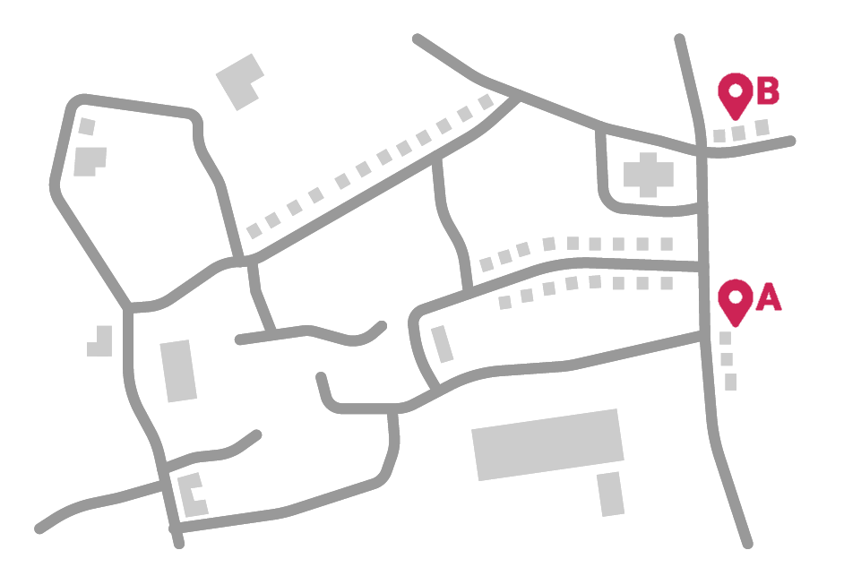
How many routes are there?
Starter activity
The activity sheet contains a road network for a village. A runner wants to figure out how many routes they can take from their house (A) to the local shop (B).
The runner doesn’t like to turn back on themselves and run down the same road twice. Your routes should avoid any dead ends that would require them to turn back.

Slide 83
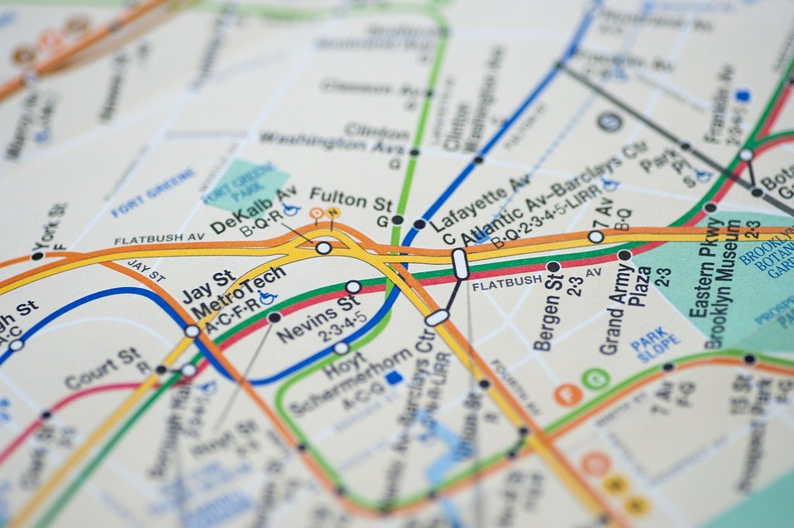
Examples of networks
Activity 1
You can see examples of networks all around you. Transport networks can include routes for:
Trains
Trams
Boats
Planes
Cars / Lorries
Notes:
Image source: https://pixabay.com/photos/nyc-metro-plan-map-new-york-4328896/

Slide 84
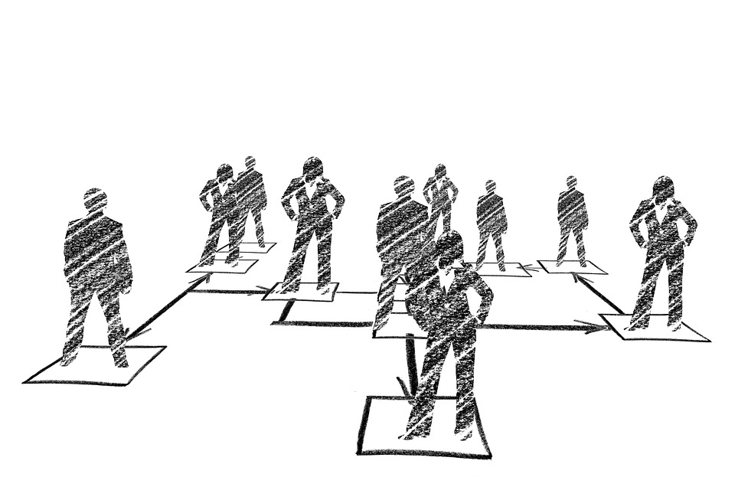
Examples of networks
Activity 1
You can see networks in businesses when you look at the hierarchy of roles in the company.
Everyone in a company is connected through line managers, directors, and executives.
Notes:
Image source: https://www.pxfuel.com/en/free-photo-ojqgo

Slide 85
Examples of networks
Activity 1
Schools can also form networks when they join with other schools to share ideas and resources.
🏫
🏫
🏫
🏫
🏫
Notes:
Image source: https://www.iemoji.com/view/emoji/114/travel-places/school

Slide 86
Drawing a network
Activity 1
All networks can be visualised (drawn) using a graph made up of nodes and edges.
Here is the village map again.

Slide 87
Drawing a network
Activity 1
The nodes are the circles and these represent the items that form the connections.
Nodes can be used to represent many things. You will discover more examples throughout this unit.

Slide 88
Drawing a network
Activity 1
The edges are the lines between the nodes and these represent the connections.

Slide 89
A computer network
Activity 1
A computer network is more than one computer connected together and able to share resources.
You can represent computer networks using graphs like these too.

Slide 90

How do computers share resources?
Activity 2
There are two fundamental roles in a computer network.
Role 1
The client, which puts in a request for data.
Role 2
The server, which fulfils that request.
Client
Server
Notes:
Image source: https://pixabay.com/vectors/laptop-pc-computer-technology-2243898/

Slide 91
Two models
Activity 2
The relationship between the client and the server can be organised in different ways.
The most common are:
The client–server model
The peer-to-peer model
Client
Server
Notes:
Image source: https://pixabay.com/vectors/laptop-pc-computer-technology-2243898/

Slide 92
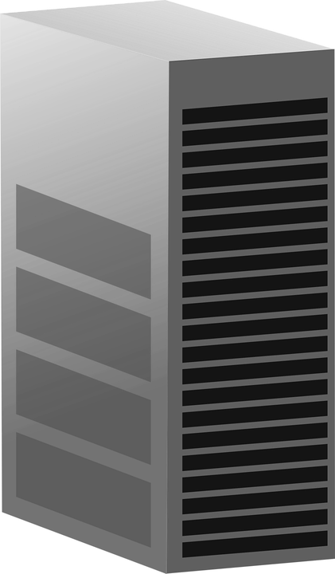
The client–server model
Activity 2
In the client–server model, a dedicated server will fulfil requests for one or more clients.
You will learn more about this next lesson.
Server
Client
Client
Client
Notes:
Image source: https://pixabay.com/vectors/server-computer-mainframe-146615/
Image source: https://pixabay.com/vectors/laptop-pc-computer-technology-2243898/

Slide 93
The peer-to-peer model
Activity 2
With a peer-to-peer model, each device can perform the role of the client and the server.
Server
Server
Server
Client
Client
Client
Server
Server
Server
Client
Client
Client
Notes:
Image source: https://pixabay.com/vectors/laptop-pc-computer-technology-2243898/

Slide 94

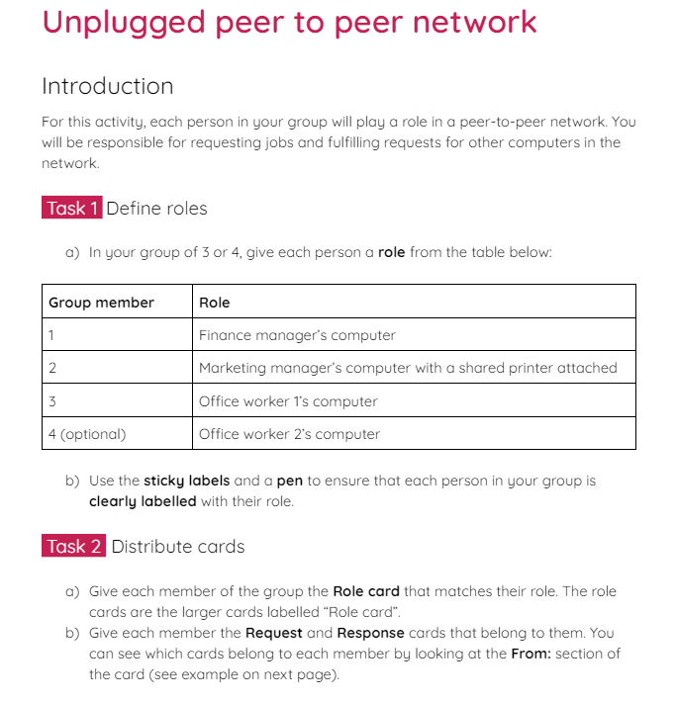
The peer-to-peer model
Activity 2
In groups of 3, you will take part in an unplugged activity where you act out various scenarios performed using the peer-to-peer model.
Read your instructions on the activity 2 sheet carefully to set up the task. Scenario one will be completed together using the following slides.

Slide 95
Scenario 1
Activity 2
Office worker 1 sends a request for the file Company_logo.png
Marketing manager receives the request and sends the file Company_logo.png
Finance manager sends a print request for the file Annual_budget.xls
Marketing manager actions the print request from Finance manager
Notes:
Image source: https://pixabay.com/vectors/laptop-pc-computer-technology-2243898/

Slide 96
Scenario 1
Activity 2
(optional) Office worker 2 sends a request for the file Website_animation.gif
(optional) Marketing manager receives the request and sends the file Website_animation.gif
Office worker 1 sends a print request for the file Welcome_letter.doc
Marketing manager actions the print request from Office worker 1
Notes:
Image source: https://pixabay.com/vectors/laptop-pc-computer-technology-2243898/

Slide 97
Scenario 1
Activity 2
Marketing manager sends a request for the file Customer_database.db
Finance manager receives the request and sends the file Customer_database.db
Marketing manager requests to print Company_logo.png
Marketing manager actions the request to print Company_logo.png
Notes:
Image source: https://pixabay.com/vectors/laptop-pc-computer-technology-2243898/

Slide 98
The peer-to-peer model
Activity 2
Now complete scenarios two and three in your individual groups.
After completing the scenarios, reflect on the advantages and disadvantages of using the peer-to-peer model.

Slide 99
Advantages and disadvantages
Activity 2
Choose one person from your group to share the advantages and disadvantages that you considered whilst completing the activity.
Notes:
Image source: https://pixabay.com/vectors/laptop-pc-computer-technology-2243898/

Slide 100
Advantages and disadvantages: model answers
Activity 2
Advantages:
Clients are not dependent on one single server
Resources can be shared between computers (e.g. printers)
It doesn’t require expensive equipment to set up
If more than one computer in the network hosts a file, then the client can request it from the device that is closest
Notes:
Image source: https://pixabay.com/vectors/laptop-pc-computer-technology-2243898/

Slide 101
Advantages and disadvantages: model answers
Activity 2
Disadvantages:
Using a shared peripheral, like a printer, can lead to a computer slowing down whilst processing many requests
If a host computer breaks down, this can cause files or peripherals that are hosted by it to be unavailable
There is no central backup system
There is no central way to provide security for the network
Notes:
Image source: https://pixabay.com/vectors/laptop-pc-computer-technology-2243898/

Slide 102
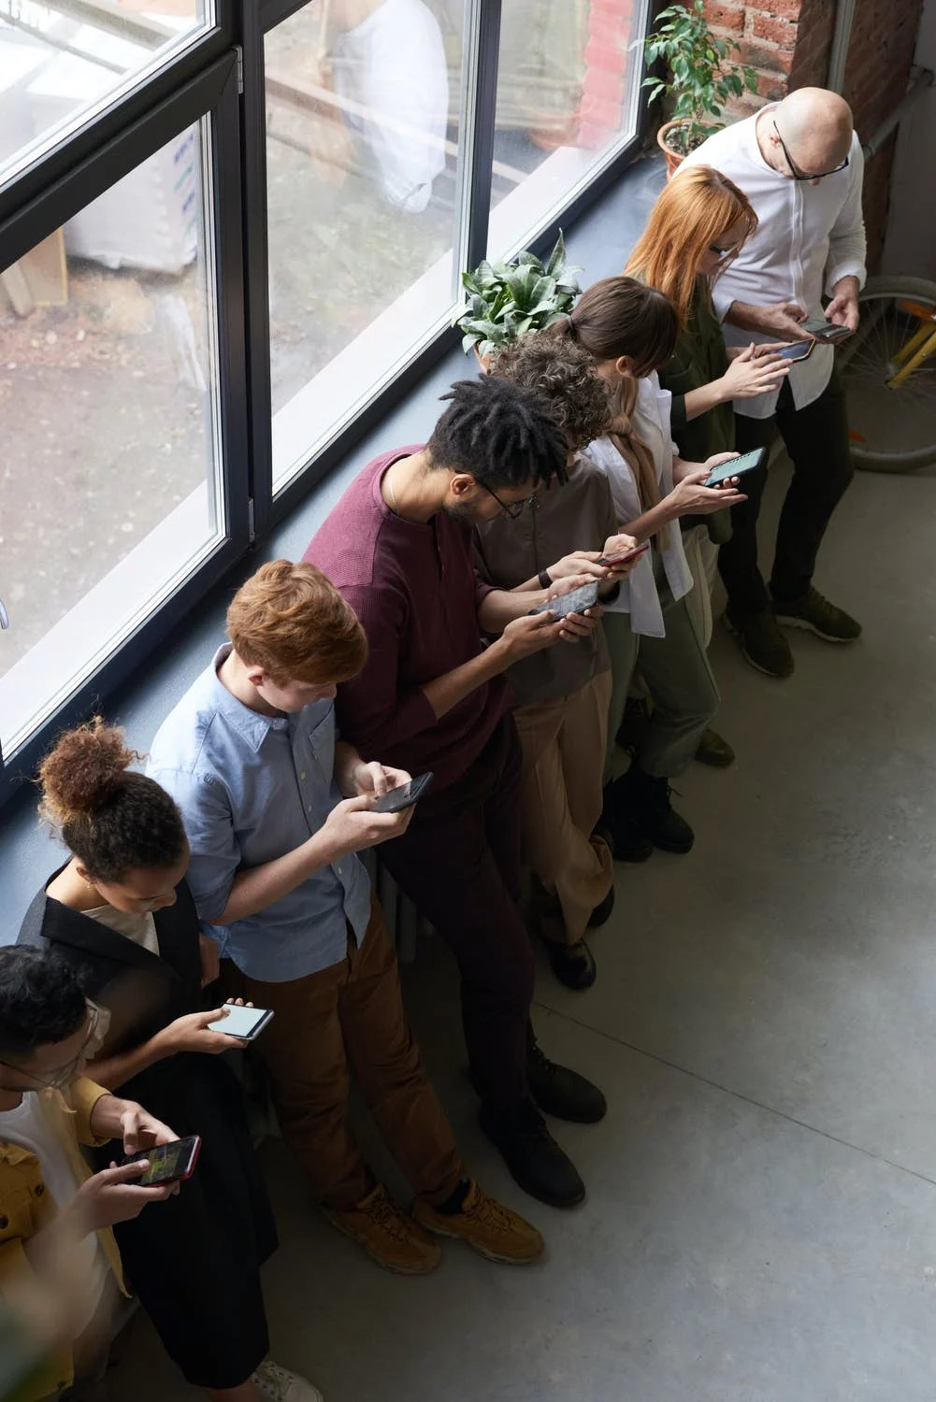
Peer-to-peer network: real-world examples
Activity 3
A temporary peer-to-peer network can be set up between trusted friends or colleagues to share files between devices.
Modern smartphones typically have features that allow you to set up temporary connections to share photos, videos, or document files.
Notes:
Image source: https://www.pexels.com/photo/people-holding-their-phones-3184435/

Slide 103
Peer-to-peer network: real-world examples
Activity 3
Temporary peer-to-peer connections can also be created using other devices like computers and laptops to share files.
Notes:
Image source: https://www.pexels.com/photo/people-holding-their-phones-3184435/

Slide 104

Peer-to-peer network: real-world examples
Activity 3
Another example is streaming and on-demand TV services.
The peer-to-peer model can be used to make streaming faster for the users and reduce the load on the provider’s network.
Notes:
Image source: https://www.pexels.com/photo/black-children-using-touchpad-of-laptop-on-sofa-6437861/

Slide 105
Lesson: The client–server model
Computer networks
Notes:
Last updated 30-11-2021
Resources are updated regularly - the latest version is available at: the-cc.io/curriculum.
This resource is licensed by the Raspberry Pi Foundation under a Creative Commons Attribution-NonCommercial-ShareAlike 4.0 International license. To view a copy of this license, visit, see creativecommons.org/licenses/by-nc-sa/4.0/.

Slide 106
Write a definition
Starter activity
Define – computer network
A computer network is two or more computers connected together, sharing resources.
Define – peer-to-peer
A type of connection used in a network. Each device in a peer-to-peer network has equal responsibility. They can act as both client and server.
Server
Server
Server
Client
Client
Client
Server
Server
Server
Client
Client
Client
Notes:
Image source: https://pixabay.com/vectors/laptop-pc-computer-technology-2243898/

Slide 107
Client–server model
Activity 1
In the client–server model there are two main roles:
The client
The server
Clients make requests. This could be for all sorts of tasks like requesting files, accessing emails, or printing a document.
Servers fulfil the requests from the client.
Server
Client
Client
Client
Notes:
Image source: https://pixabay.com/vectors/server-computer-mainframe-146615/
Image source: https://pixabay.com/vectors/laptop-pc-computer-technology-2243898/

Slide 108
Client–server model
Activity 1
A server is often a powerful machine that carries out multiple requests from all of the clients on the network.
All requests go via the server, unlike a peer-to-peer network, where all of the devices can fulfill requests.
Server
Client
Client
Client
Notes:
Image source: https://pixabay.com/vectors/server-computer-mainframe-146615/
Image source: https://pixabay.com/vectors/laptop-pc-computer-technology-2243898/

Slide 109
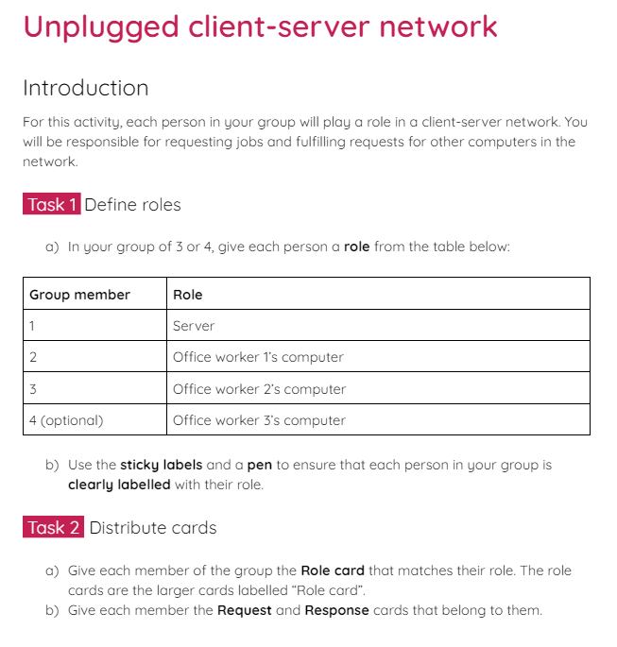
Client–server model
Activity 1
In groups of 3, you will take part in an unplugged activity where you act out various scenarios performed using the client–server model.
Read your instructions on the activity 1 sheet carefully to set up the task. Scenario one will be completed together using the following slides.

Slide 110
Scenario 1
Activity 1
Office worker 1 sends a request for the file Company_logo.png
Server receives the request and sends the file Company_logo.png
Office worker 2 sends a print request for the file Annual_budget.xls
Server actions the print request from Office worker 2
Server
Client
Client
Client
Notes:
Image source: https://pixabay.com/vectors/server-computer-mainframe-146615/
Image source: https://pixabay.com/vectors/laptop-pc-computer-technology-2243898/

Slide 111
Scenario 1
Activity 1
(optional) Office worker 3 sends a request for the file Website_animation.gif
(optional) Server receives the request and sends the file Website_animation.gif
Office worker 1 sends a print request for the file Welcome_letter.doc
Server actions the print request from Office worker 1
Server
Client
Client
Client
Notes:
Image source: https://pixabay.com/vectors/server-computer-mainframe-146615/
Image source: https://pixabay.com/vectors/laptop-pc-computer-technology-2243898/

Slide 112
Scenario 1
Activity 1
Office worker 2 sends a request for the file Customer_database.db
Server receives the request and sends the file Customer_database.db
Office worker 1 requests to print Company_logo.png
Server actions the request to print Company_logo.png
Server
Client
Client
Client
Notes:
Image source: https://pixabay.com/vectors/server-computer-mainframe-146615/
Image source: https://pixabay.com/vectors/laptop-pc-computer-technology-2243898/

Slide 113
The client–server model
Activity 1
Now complete scenarios two and three in your individual groups.
After completing the scenarios, reflect on the advantages and disadvantages of using the client–server model.
Server
Client
Client
Client
Notes:
Image source: https://pixabay.com/vectors/server-computer-mainframe-146615/
Image source: https://pixabay.com/vectors/laptop-pc-computer-technology-2243898/

Slide 114
Advantages and disadvantages
Activity 1
Choose one person from your group to share the advantages and disadvantages that you identified whilst completing the activity.
Server
Client
Client
Client
Notes:
Image source: https://pixabay.com/vectors/server-computer-mainframe-146615/
Image source: https://pixabay.com/vectors/laptop-pc-computer-technology-2243898/

Slide 115
Advantages and disadvantages: model answers
Activity 1
Advantages:
All of the files are stored on one central server
All of the peripherals are processed via the server
If a client machine breaks it won’t affect the whole network
A backup can be taken of the server, rather than individual client machines
Server
Client
Client
Client
Notes:
Image source: https://pixabay.com/vectors/server-computer-mainframe-146615/
Image source: https://pixabay.com/vectors/laptop-pc-computer-technology-2243898/

Slide 116
Advantages and disadvantages: model answers
Activity 1
Disadvantages:
They are expensive to set up, compared to stand-alone computers or a peer-to-peer network
A specialist network administrator is required to set up the network
If the server fails, then everyone connected to that server is disrupted
Server
Client
Client
Client
Notes:
Image source: https://pixabay.com/vectors/server-computer-mainframe-146615/
Image source: https://pixabay.com/vectors/laptop-pc-computer-technology-2243898/

Slide 117

Peer-to-peer vs client–server model
Activity 2
The client–server model is typically used where a central server is required.
For example, a business might need employees to share files and software. These are stored and accessed via the central server to allow for shared access.
Notes:
Image source: https://pixabay.com/photos/office-business-men-businessmen-1209640/

Slide 118

Peer-to-peer vs client–server model
Activity 2
Online gaming sites can often use a client–server model to provide shared access to an online environment.
All of the players access the gaming environment via the same server. This allows them to play together on the same game in real time.
Notes:
Image source: https://www.pexels.com/photo/a-woman-playing-video-game-7915492/

Slide 119
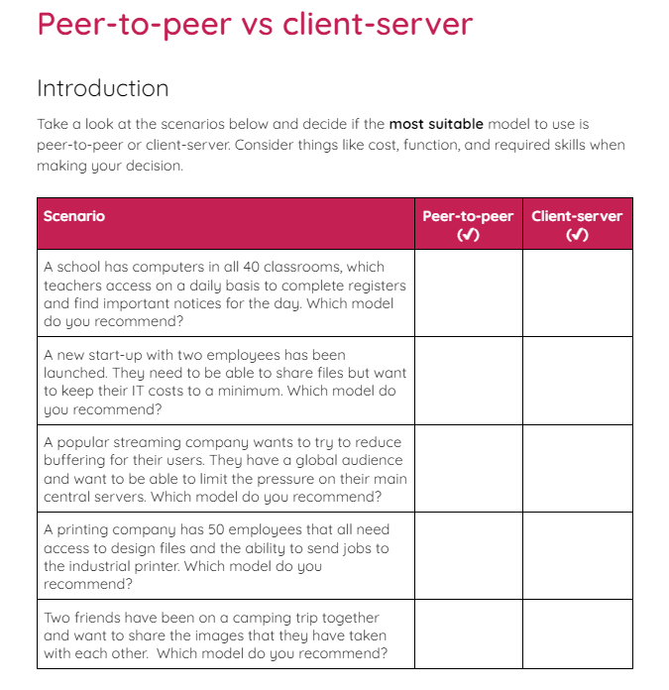
Peer-to-peer vs client–server model
Activity 2
Read the scenarios on the activity 2 sheet and decide if the people should use the peer-to-peer model or the client–server model.

Slide 120
PANs, LANs, and WANs
Activity 3
The two most common models for a computer network are peer-to-peer and client–server.
You can also describe a network by the type of area that they operate in.
Firstly, there is a Personal Area Network or PAN.
This is typically limited to a single user in the network with multiple connected devices.

Slide 121

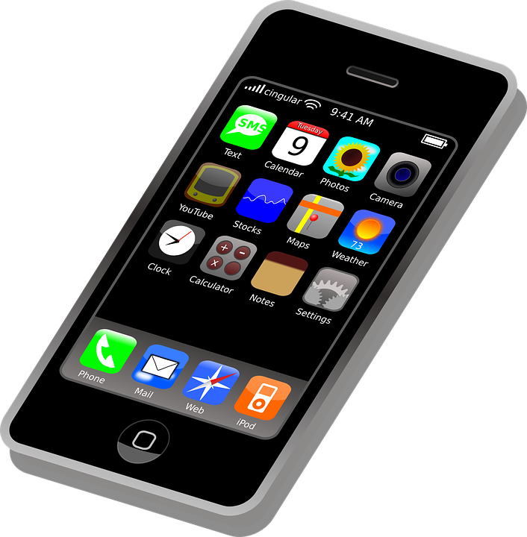
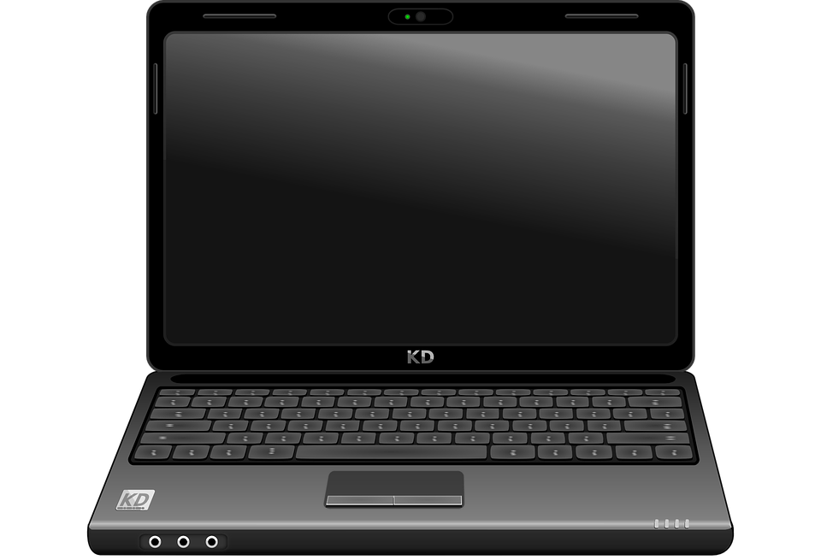
Personal area network (PAN)
Activity 3
A single user might have a laptop that is connected to a smartphone to share the internet access.
The user might also have a smartwatch that is connected to the smartphone to track heart rate, steps, and notify the user of new messages.
Notes:
Smartwatch image: https://pixabay.com/vectors/watch-wristwatch-time-clock-2649380/
Laptop image: https://pixabay.com/vectors/laptop-notebook-computer-black-158648/
Smartphone image: https://pixabay.com/vectors/iphone-cellphone-smartphone-mobile-37856/

Slide 122
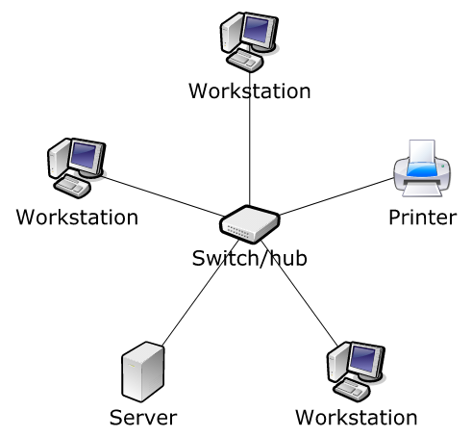
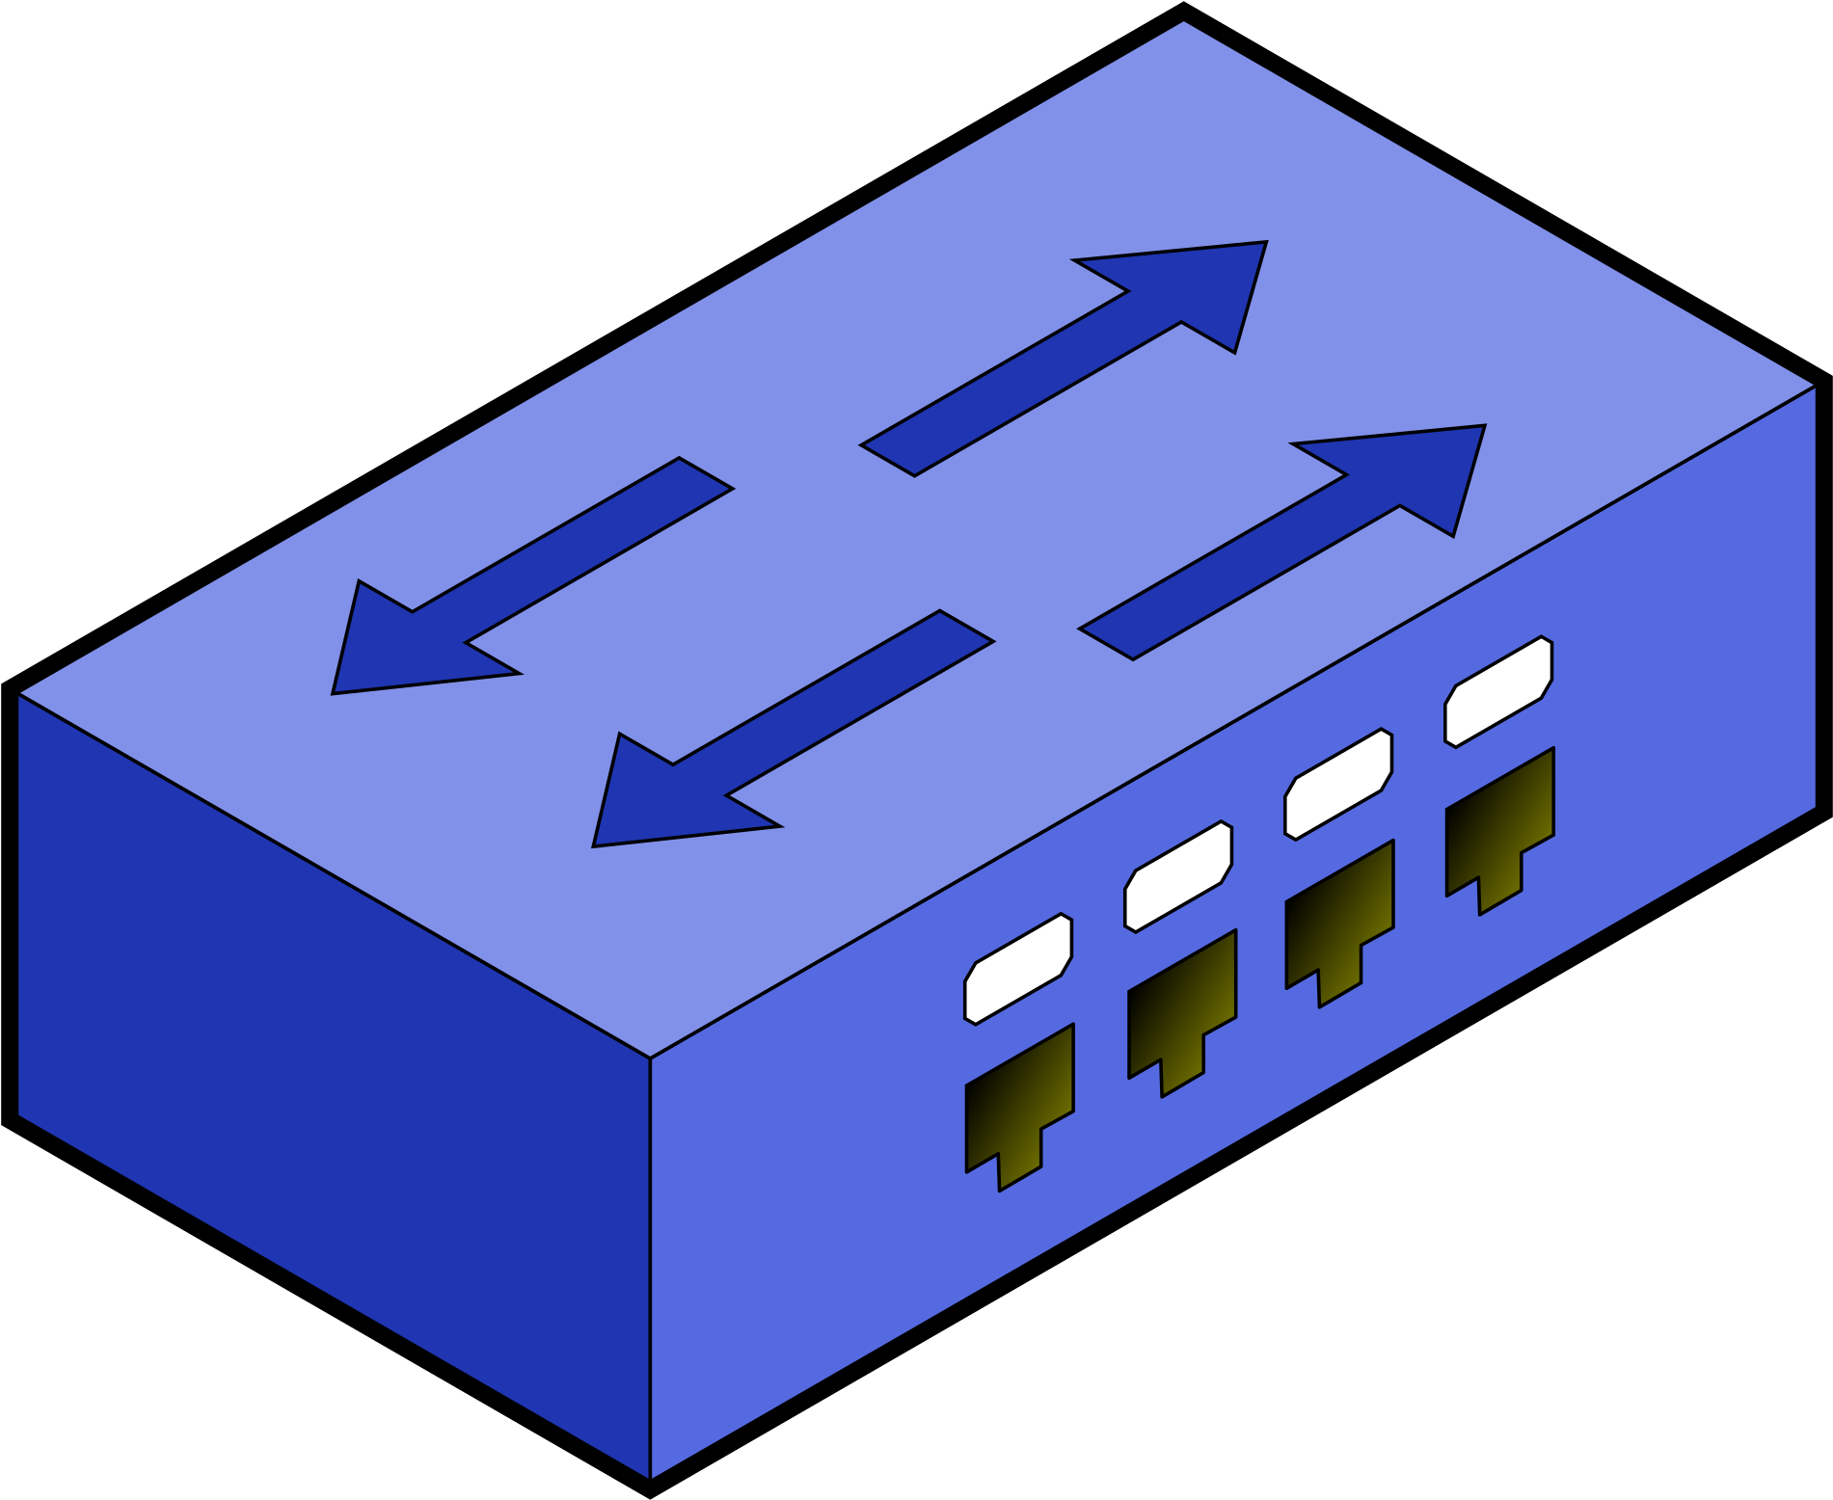
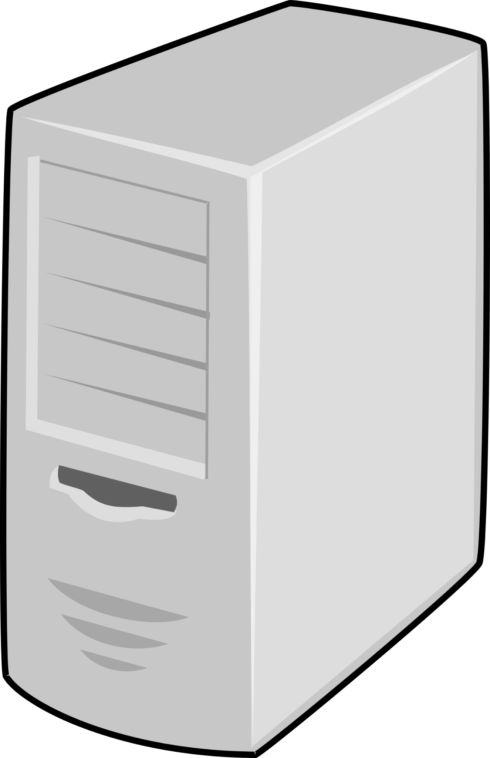
Local area network (LAN)
Activity 3
The second type of area network is a Local Area Network or LAN.
A LAN has multiple users and is typically situated in a single building or room. The devices on the network are ‘local’ to each other.
A small office will typically use a LAN to allow for shared access to files and peripherals.
Notes:
Image sources:
https://www.clipartmax.com/middle/m2i8H7b1K9A0i8H7_open-thin-client-icon/
https://www.clipartmax.com/middle/m2i8Z5K9K9H7H7b1_possible-printer-issue-fix-printer-icon/
https://www.clipartmax.com/download/m2H7K9d3K9Z5A0m2_switch-with-border-network-switch-clipart/
https://www.clipartmax.com/download/m2i8i8b1b1A0d3G6_server-server-png/

Slide 123
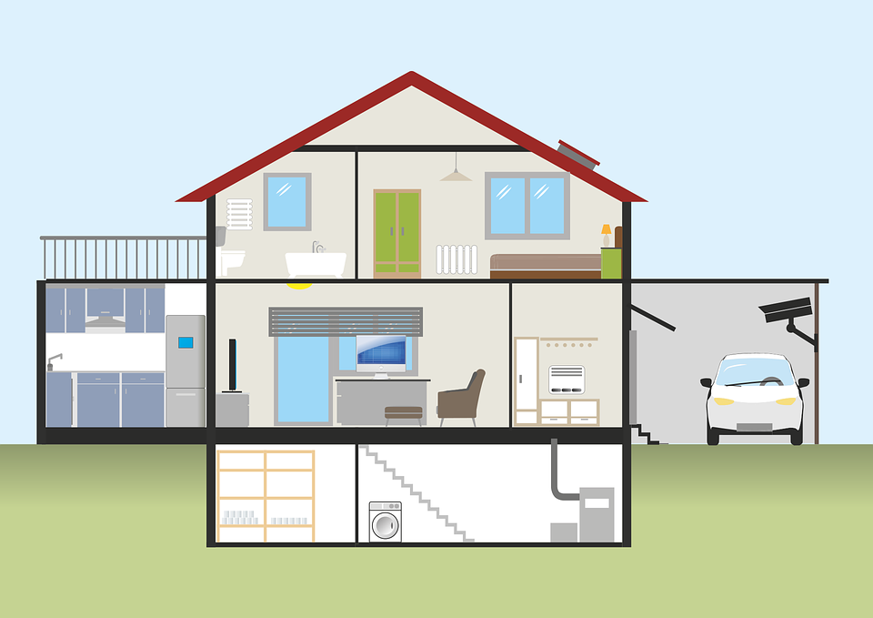
Local area network (LAN)
Activity 3
You might also see a LAN in a household. Members of the household might have laptops, smartphones, computers, and even TVs and smart devices all connected via a LAN.
Notes:
Image source: https://pixabay.com/illustrations/house-plank-garage-auto-keller-2006023/

Slide 124
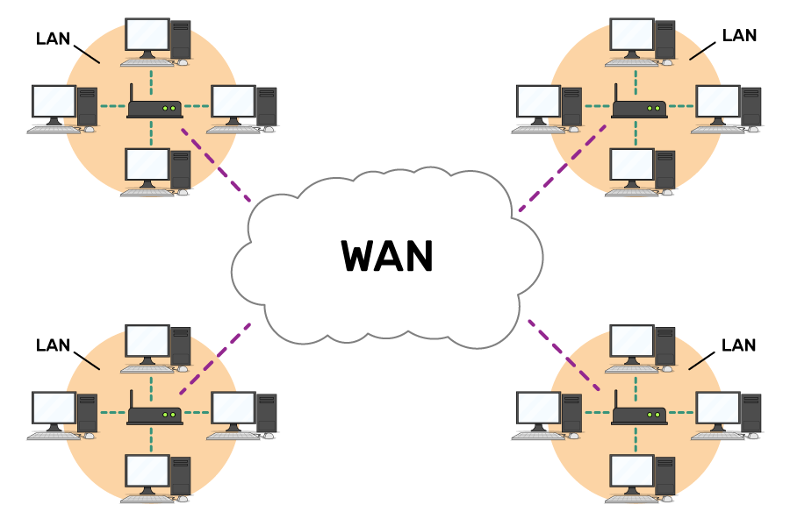
Wide area network (WAN)
Activity 3
The final type of computer network is a Wide Area Network or WAN. When devices are connected across a wider geographical area, they form a wide area network (WAN).
Often, lots of LANs are connected together to create a WAN.
Notes:
Image source: Raspberry Pi online course (futurelearn)

Slide 125

Wide area network (WAN)
Activity 3
Large businesses use WANs to share files and resources across multiple buildings in different locations.
They might have an office in Wales and and an office in Scotland, both requiring access to shared files. A WAN can make this possible.
Office 1
Office 2
Notes:
Image source: https://pixabay.com/vectors/united-kingdom-map-great-britain-36481/

Slide 126
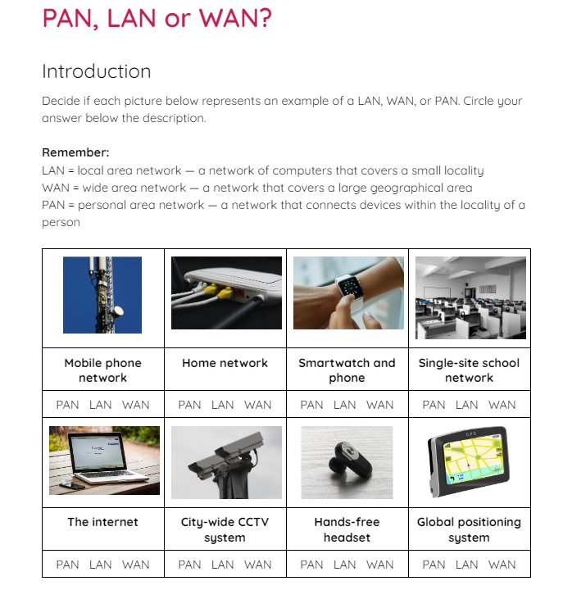
PANs, LANs, and WANs
Activity 3
Use the activity 3 sheet to decide if the image represents a PAN, a LAN, or a WAN.

Slide 127
Lesson: Network hardware
Computer networks
Notes:
Last updated 30-11-2021
Resources are updated regularly - the latest version is available at: the-cc.io/curriculum.
This resource is licensed by the Raspberry Pi Foundation under a Creative Commons Attribution-NonCommercial-ShareAlike 4.0 International license. To view a copy of this license, visit, see creativecommons.org/licenses/by-nc-sa/4.0/.

Slide 128
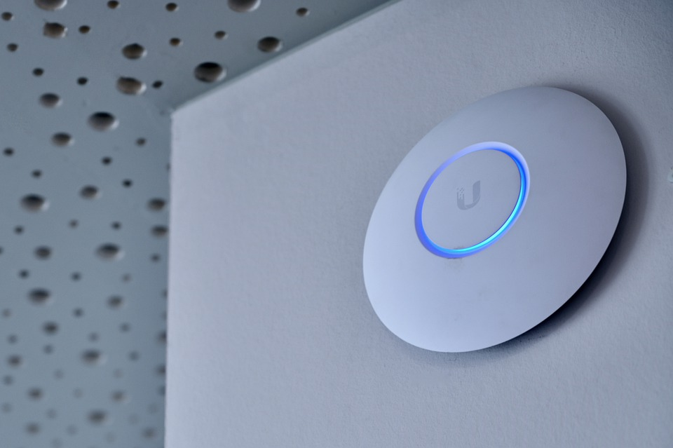

Wireless access point
Activity 1
You may have noticed a wireless access point (WAP) in locations that offer ‘free WiFi’ for you to use.
They are typically found in restaurants, shopping centres, and on public transport.
If you have wireless internet in your home, you will also have a wireless access point. This is often built in to the device provided by your internet supplier.
Notes:
Image source: https://pixabay.com/photos/access-point-internet-wifi-wlan-5002809/

Slide 129
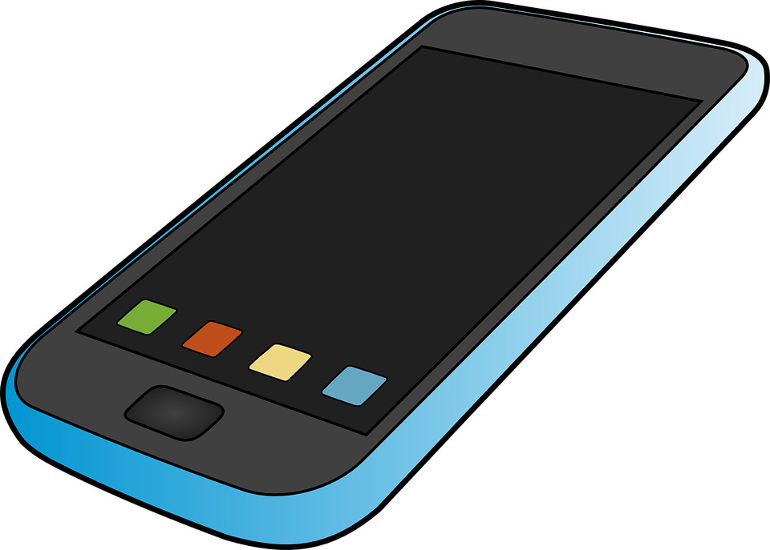
Wireless access point
Activity 1
A wireless access point (WAP) connects to a wired network and provides a wireless network radio signal for wireless devices to connect to.
The WAP provides wireless access to the network. It is not the device that provides internet access, that job is for another device.
Notes:
Image source: https://pixabay.com/vectors/mobile-phone-communication-157065/

Slide 130
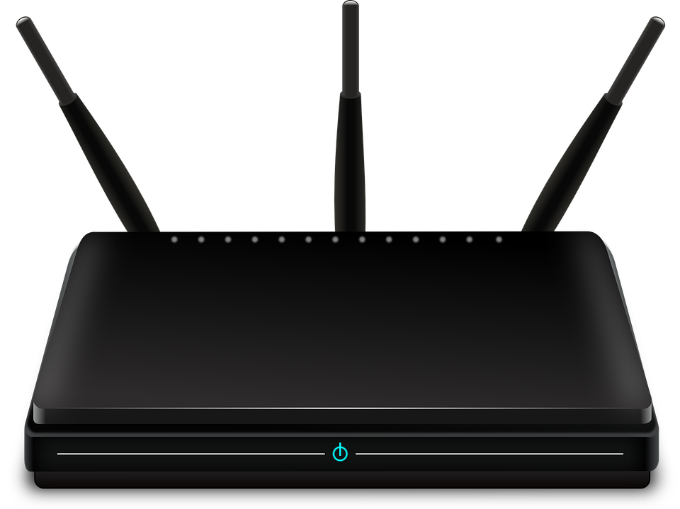

Router
Activity 1
Routers are responsible for moving data from one network to another.
A common use for a router is to connect a network to the internet (which is also a network).
Notes:
Image source: https://pixabay.com/vectors/router-switch-symbol-network-30140/

Slide 131

Router
Activity 1
To connect wirelessly to the internet, you need a wireless access point and a router.
These are often built into the same device.
Internet
Notes:
Image source: https://pixabay.com/vectors/cloud-thought-weather-153992/

Slide 132
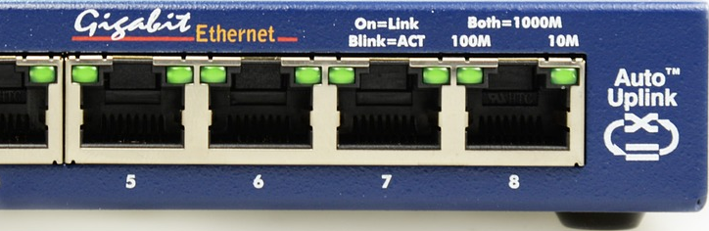

Switch
Activity 1
A switch is required if there are multiple wired connections on the network.
The switch is responsible for connecting data to the correct wired device.
Notes:
Image source: https://pixabay.com/photos/switch-network-it-distributor-nsa-490026/

Slide 133
Switch
Activity 1
A switch is only required if there are wired devices on the network.
A wireless access point will connect data to the correct wireless device.
Notes:
Image source: https://pixabay.com/vectors/router-networking-switch-internet-29336/

Slide 134
Which of these symbols is used for a router?
Activity 1
Switch
Router
WAP

Slide 135
Which device is used to connect a network to another network?
Activity 1
Switch
Router
WAP

Slide 136
Which device sends data to the correct wired device?
Activity 1
Switch
Router
WAP

Slide 137
Which device connects a wireless device to a network?
Activity 1
Switch
Router
WAP

Slide 138
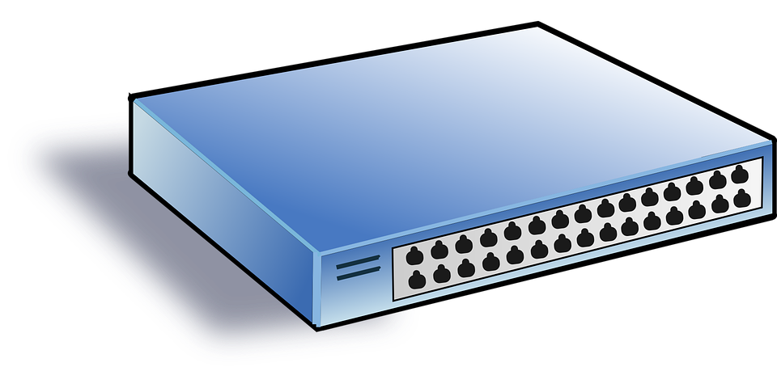

Hub
Activity 1
A hub can be used to connect multiple wired devices together.
A hub will take any incoming data and broadcast (copy and send) it to all other devices connected to the hub.
Notes:
Image source: https://pixabay.com/vectors/switch-hub-network-net-lan-35568/

Slide 139
Hub
Activity 1
Hubs were seen as a cheaper alternative to switches in the early stages of network design.
There are potential security risks with a hub because the data is broadcast to all devices instead of the specific device that needs it.
Switches are much cheaper nowadays and are often used instead of hubs.
Notes:
Image source: https://pixabay.com/vectors/switch-hub-network-net-lan-35568/

Slide 140
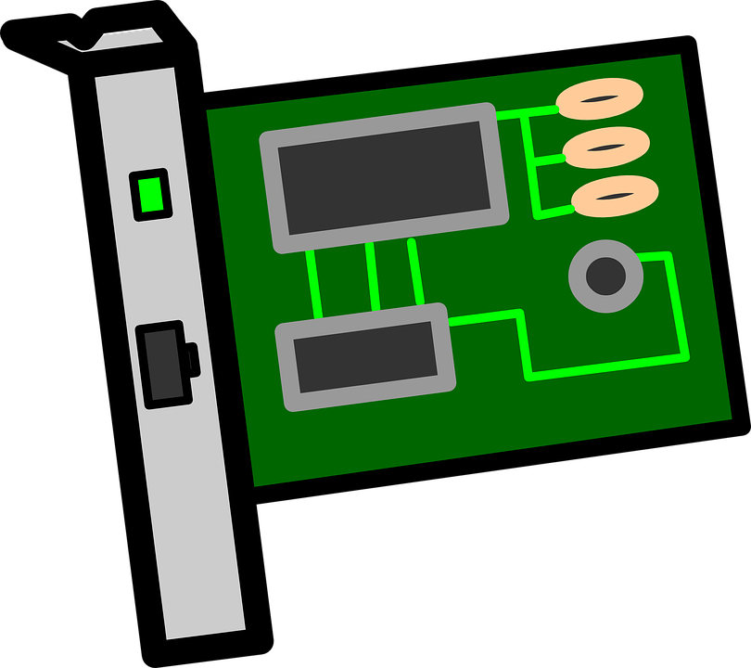
Network interface card (NIC)
Activity 1
A network interface card (NIC) enables a wired network connection between a computer and another networked device.
Notes:
Image source: https://pixabay.com/vectors/card-circuit-electronics-interface-161279/

Slide 141
Network interface card (NIC)
Activity 1
Every network interface card has a unique address called a MAC address.
MAC stands for media access control.
This unique, physical address is used to locate devices on the network.
Notes:
Image source: https://pixabay.com/vectors/card-circuit-electronics-interface-161279/

Slide 142
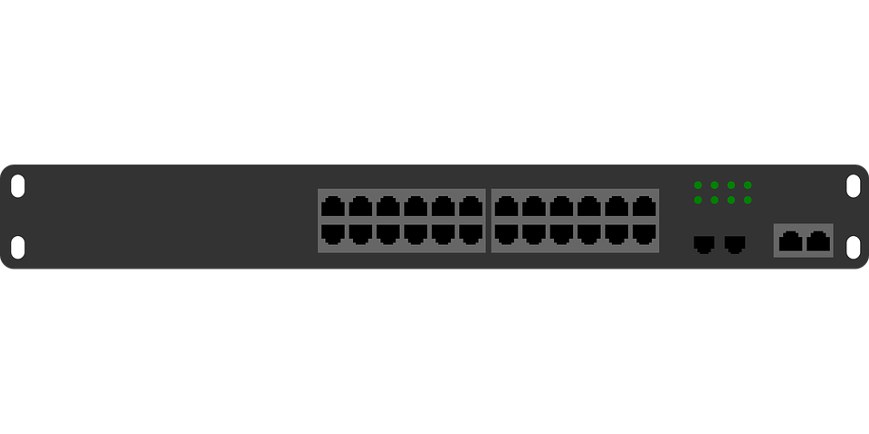

Bridge
Activity 1
A bridge is used to connect a LAN to another LAN.
When a network becomes too large it can cause lots of traffic as data moves through it.
A bridge helps to reduce the traffic by segmenting the network.
Notes:
Image source: https://pixabay.com/vectors/computer-lan-network-switch-158777/

Slide 143
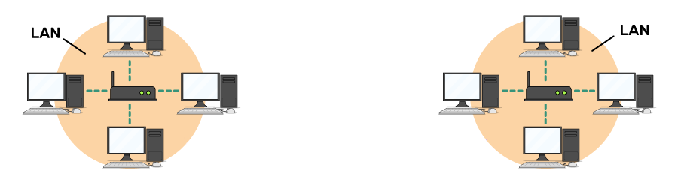
Bridge
Activity 1
Data will only pass through the bridge to the other segment or LAN if it is required by that part of the network.
Notes:
Image source: https://pixabay.com/vectors/computer-lan-network-switch-158777/ and the Raspberry Pi graphic from the Futurelearn course

Slide 144
Which device broadcasts data to all wired devices attached to it?
Activity 1
Hub

Slide 145
Which device links one LAN to another LAN?
Activity 1
Bridge

Slide 146
Which device has a unique MAC address to make it identifiable on a network?
Activity 1
NIC

Slide 147
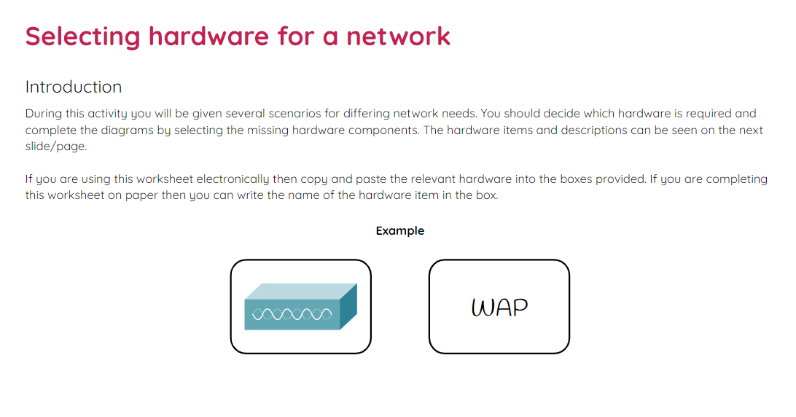
Selecting hardware for a network
Activity 2
Use the activity 2 sheet to decide which hardware items are missing from the networks based on the scenarios.
You will also be required to design your own networks for given scenarios.

Slide 148
What am I?
Plenary
I connect LANs to other LANs on a network. I am also used to segment large LANs to reduce traffic across the network.
Bridge

Slide 149
What am I?
Plenary
I am needed if you want to connect any device to the internet.
Router

Slide 150
What am I?
Plenary
I am used to securely connect wired devices to each other over a network.
Switch

Slide 151
What am I?
Plenary
If you are going to connect wireless devices to your network then you are going to need me!
Wireless Access Point
(WAP)

Slide 152
What am I?
Plenary
I must be unique so that I can be identified across a network.
MAC address

